Slide 1

Visual Abstract Instructions
Visual abstracts should read top to bottom or left to right.
We ask that abstracts be 8” wide x 5” tall; the template is set to these dimensions.
Save and send as a PowerPoint file only.
Use the fonts sizes and styles provided on the next slide. Do not use all caps.
Use the sample colors provided on the next slide.
Be sure you have rights to the icons you use, or have included proper attribution as specified by the source site. The Noun Project (https://thenounproject.com/) offers a wide selection of free icons for use with proper attribution, or allows unlimited unattributed use for $1.99 per icon. We do not cover icon costs. Suggested formatting of attribution information is in the template.
Google “visual abstracts” to see common layout examples. Please aim for simplicity.
Please note that all information you wish to present must be included on one slide. Additional text or notes will be discarded.

Slide 2
Design Element Guide
Please use slide 3 to create your visual abstract.
Use this font for small labels (Arial 16 pt)
Use this font for medium labels (Arial 18 pt)
Use this font for large labels/titles (Arial 20 pt)
Preferred arrow style
Preferred color samples

Slide 3
[Short Title/Summary of Article Topic]
[Lead author last name] et al. Clin Trans Gastroenterol. [Month Year]. [doi]
All icons above are from [source name/url].

Slide 4




Slide 5
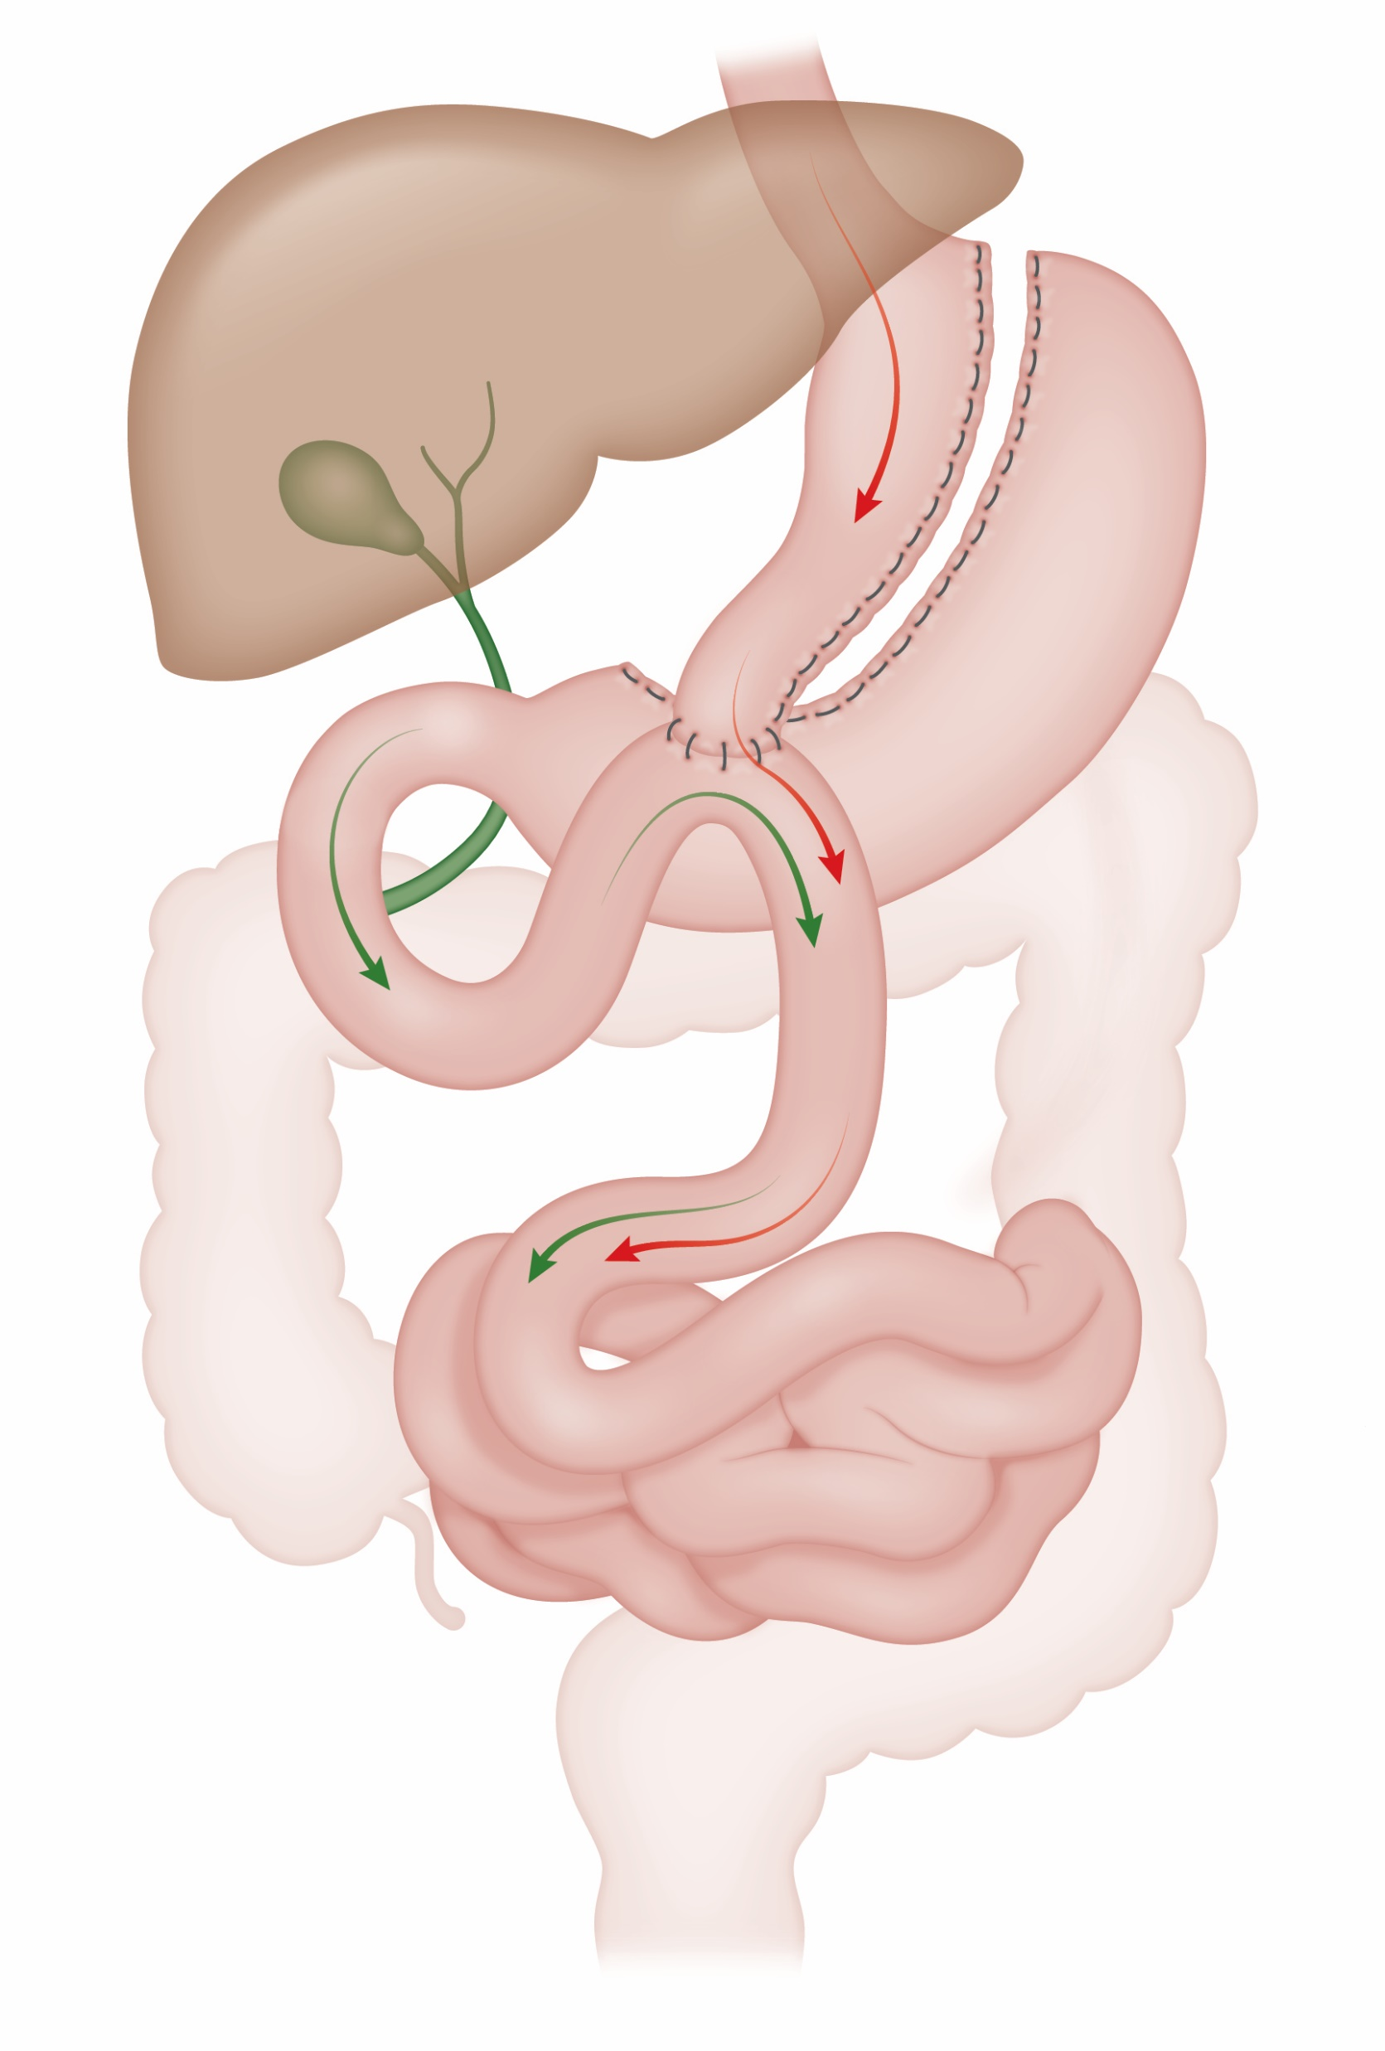

Slide 6


Slide 7
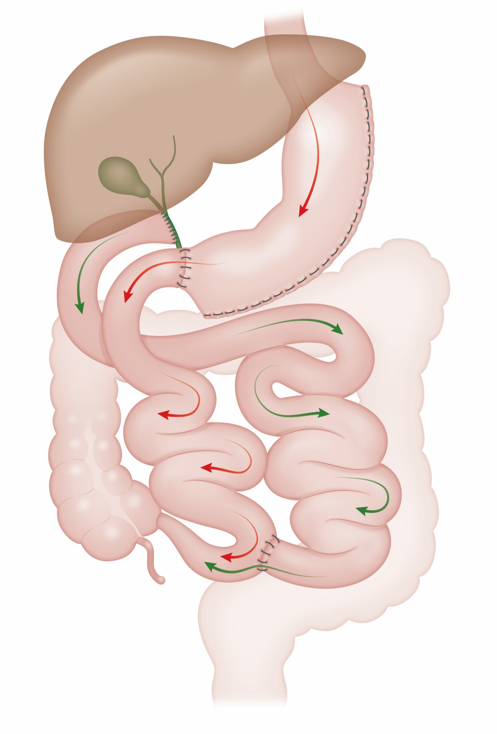
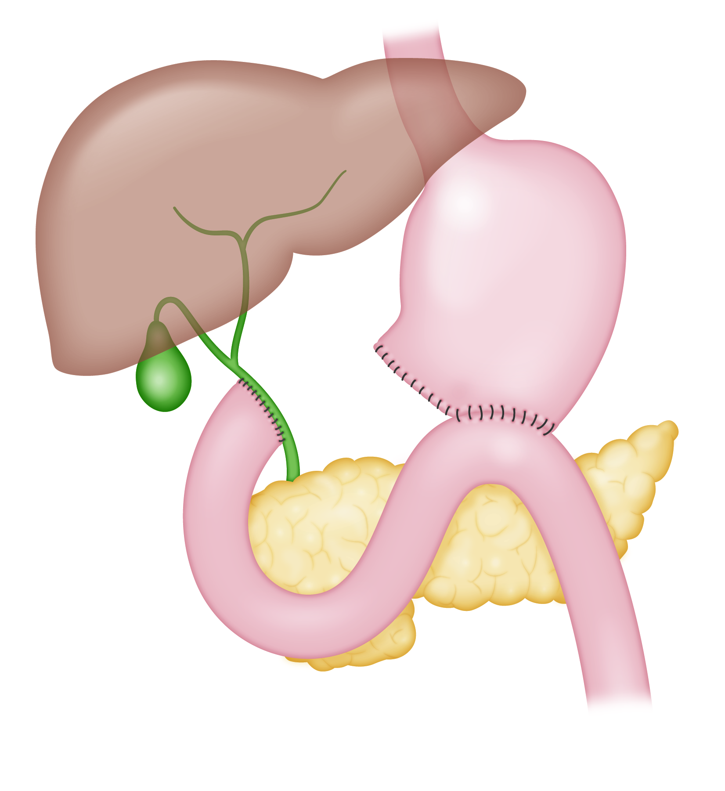
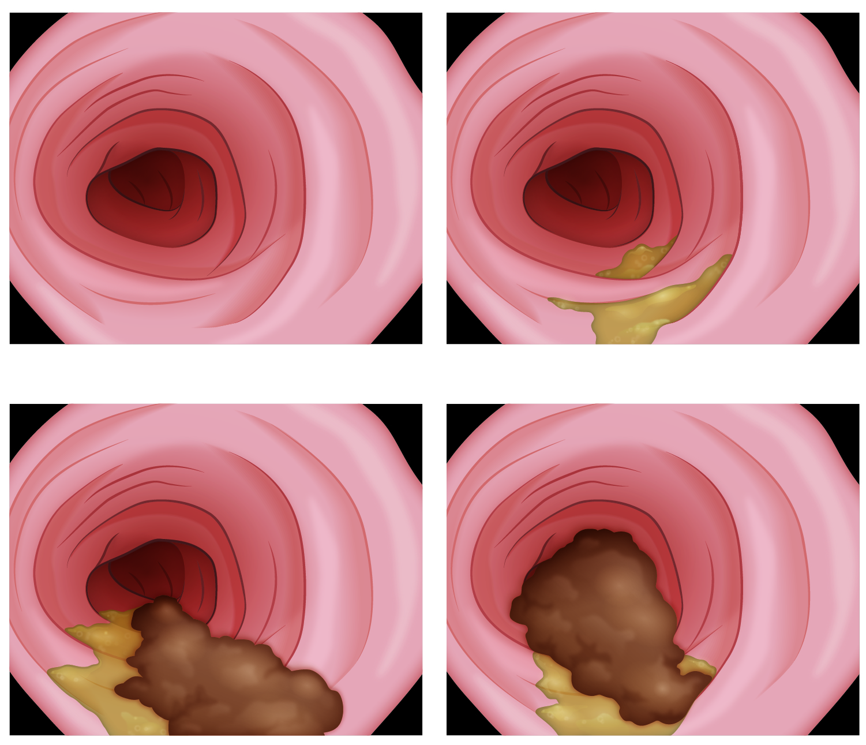

Slide 8
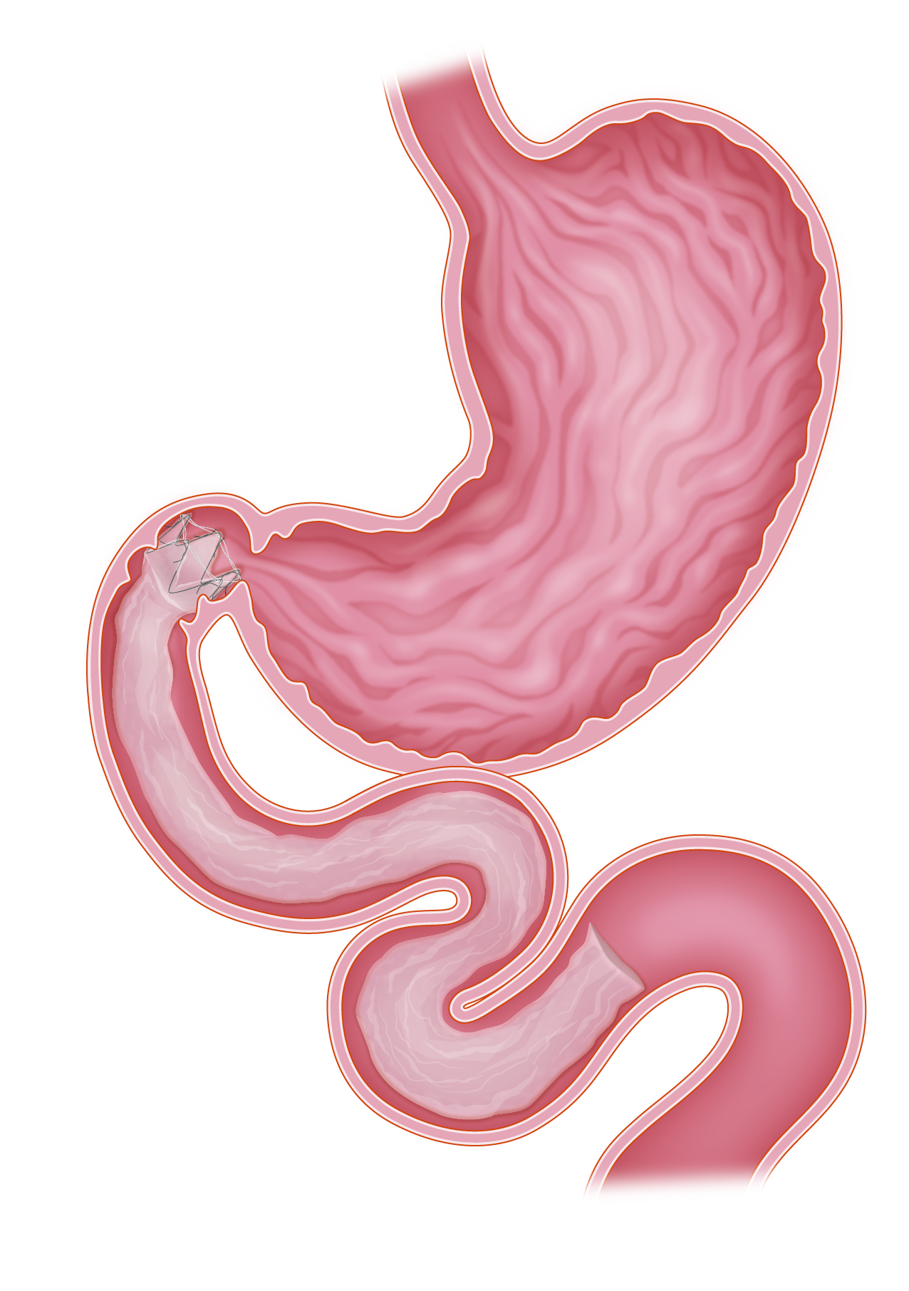



Slide 9
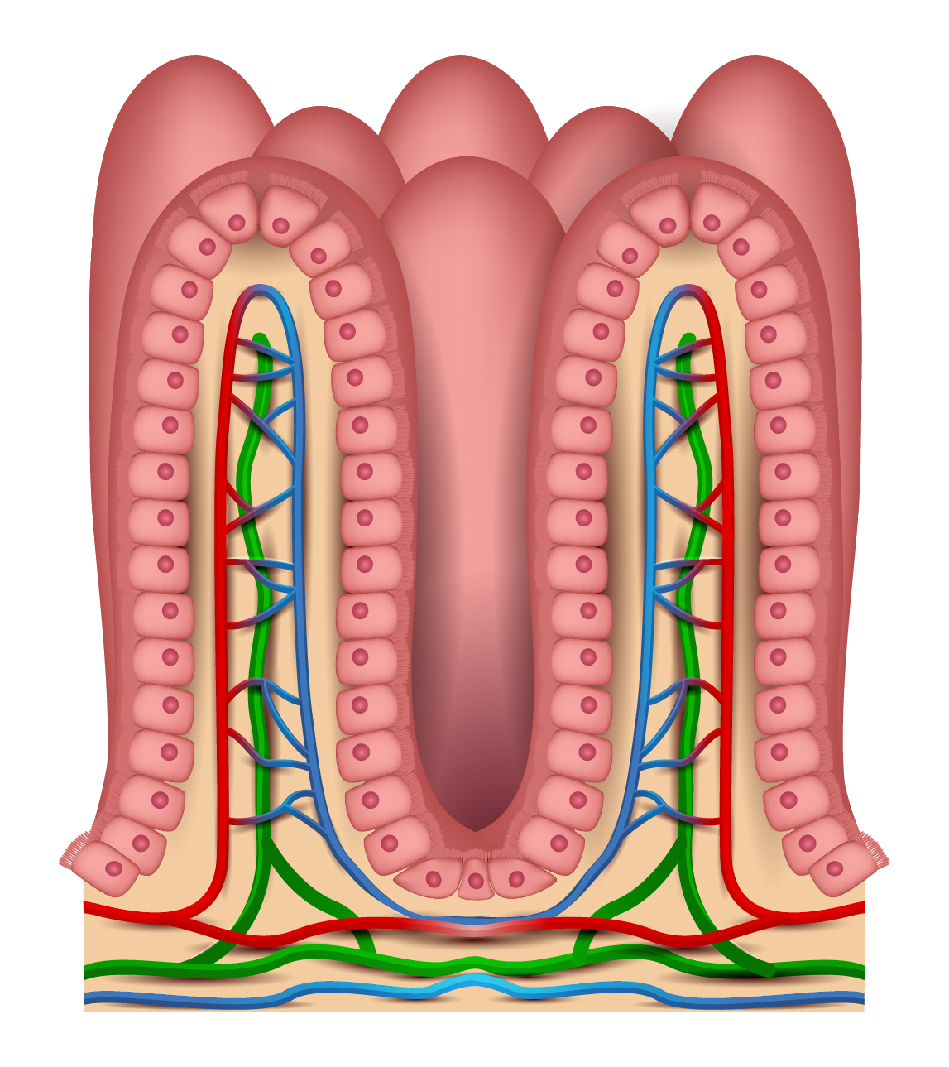



Slide 10




Slide 11
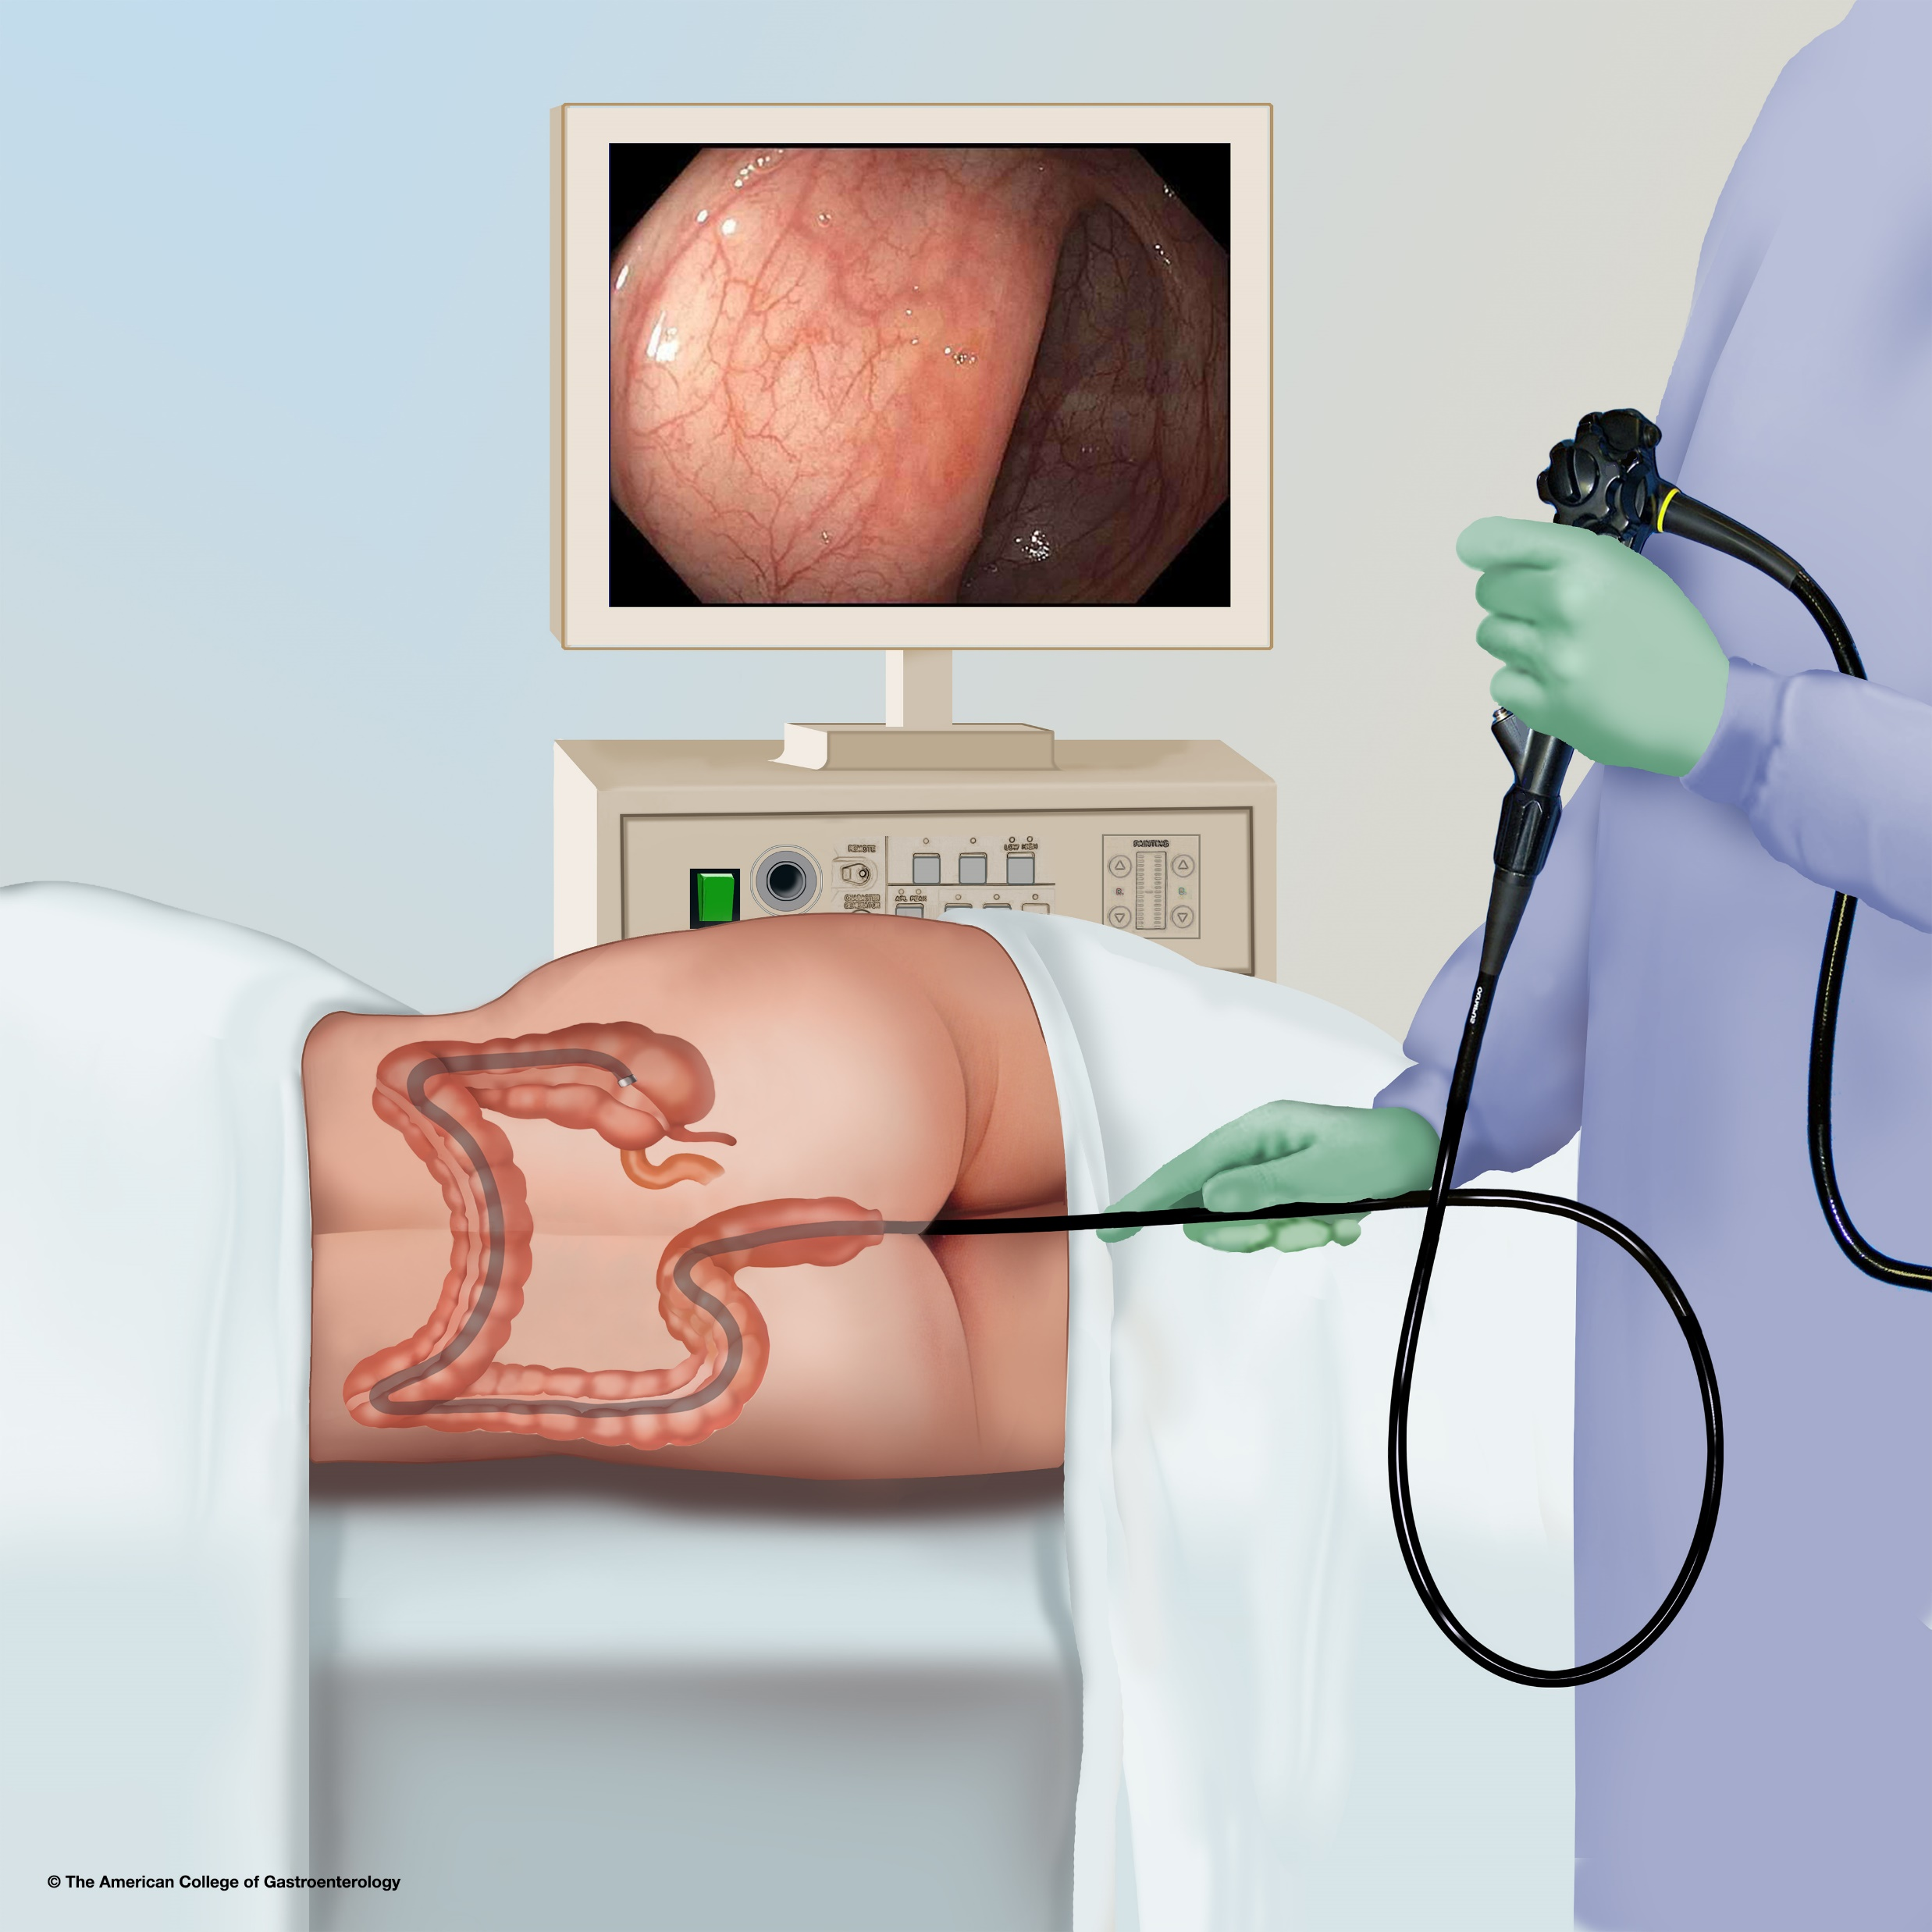

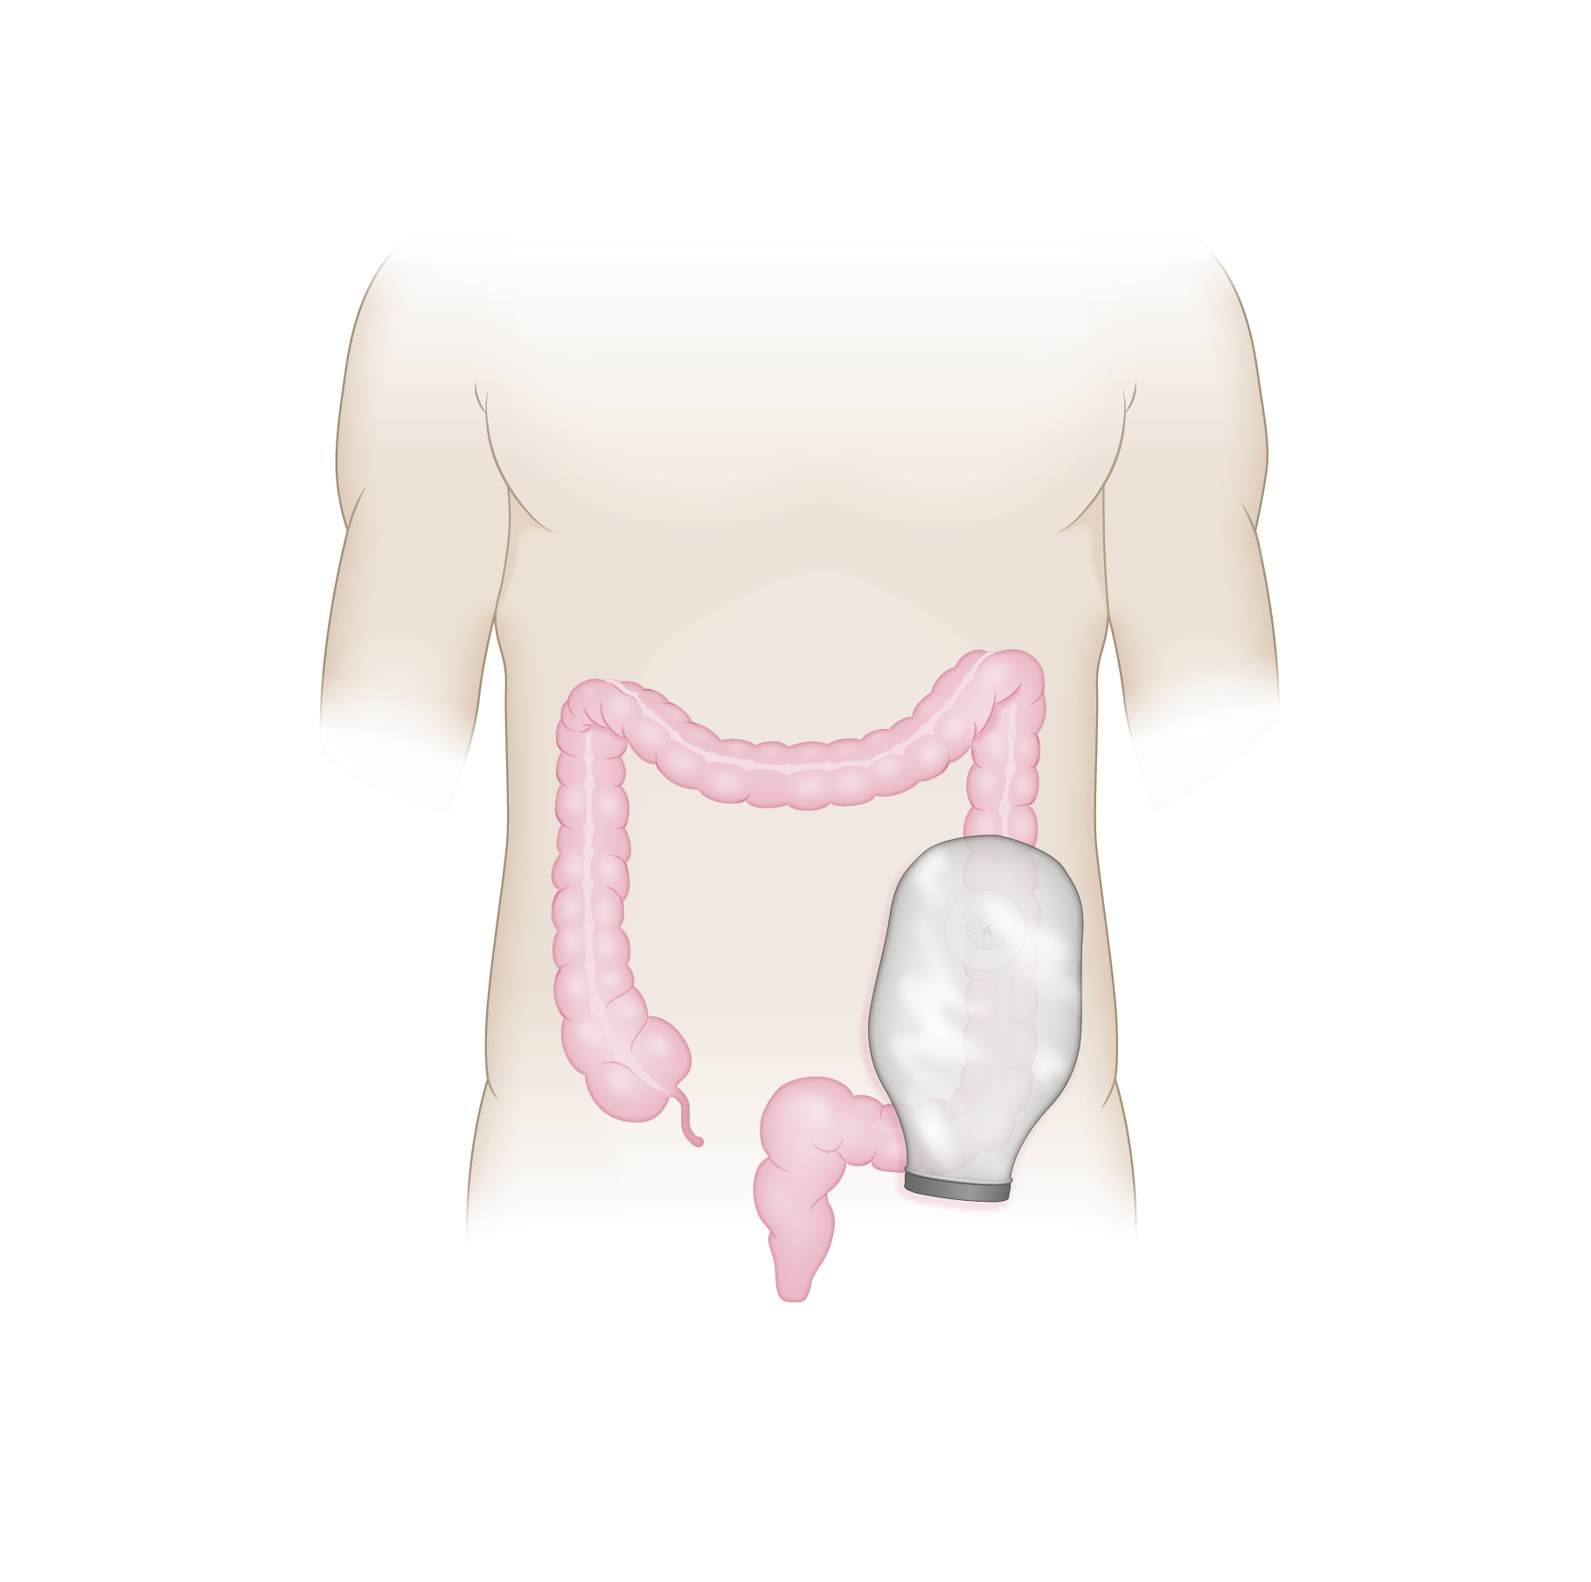

Slide 12

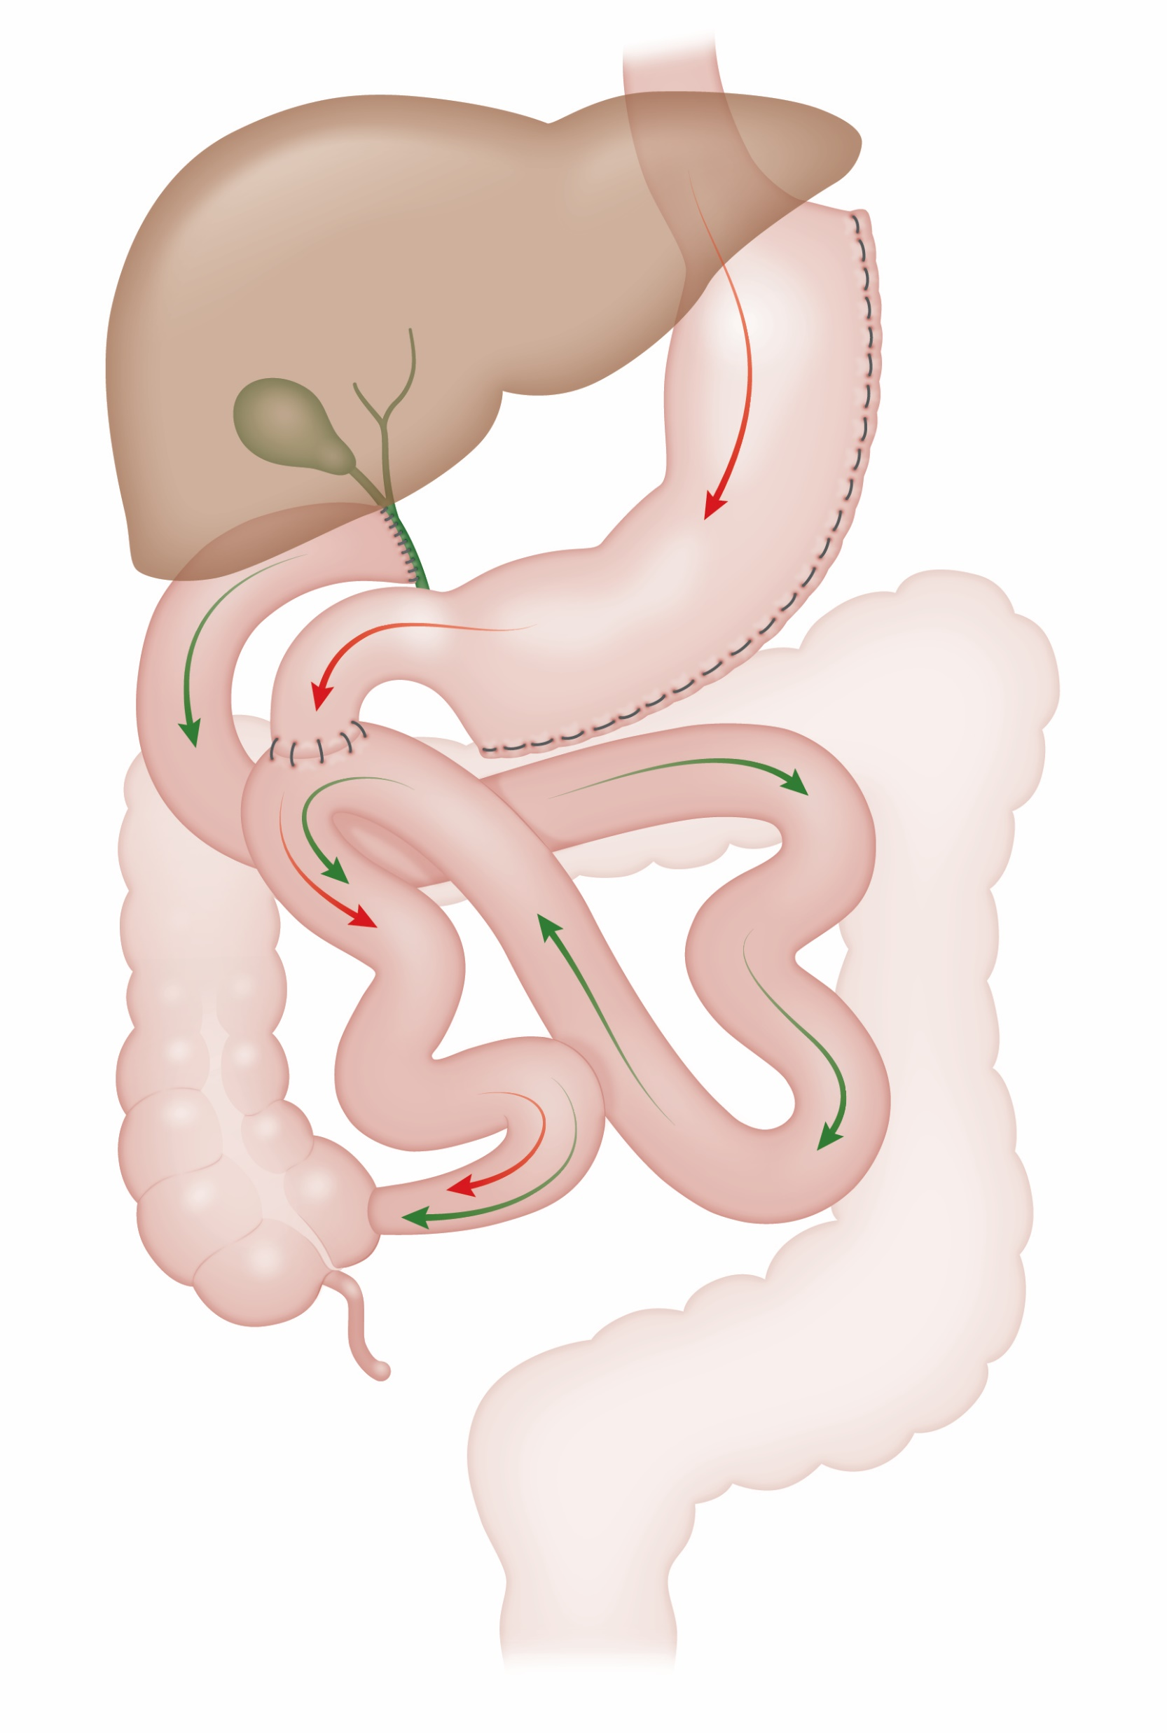


Slide 13


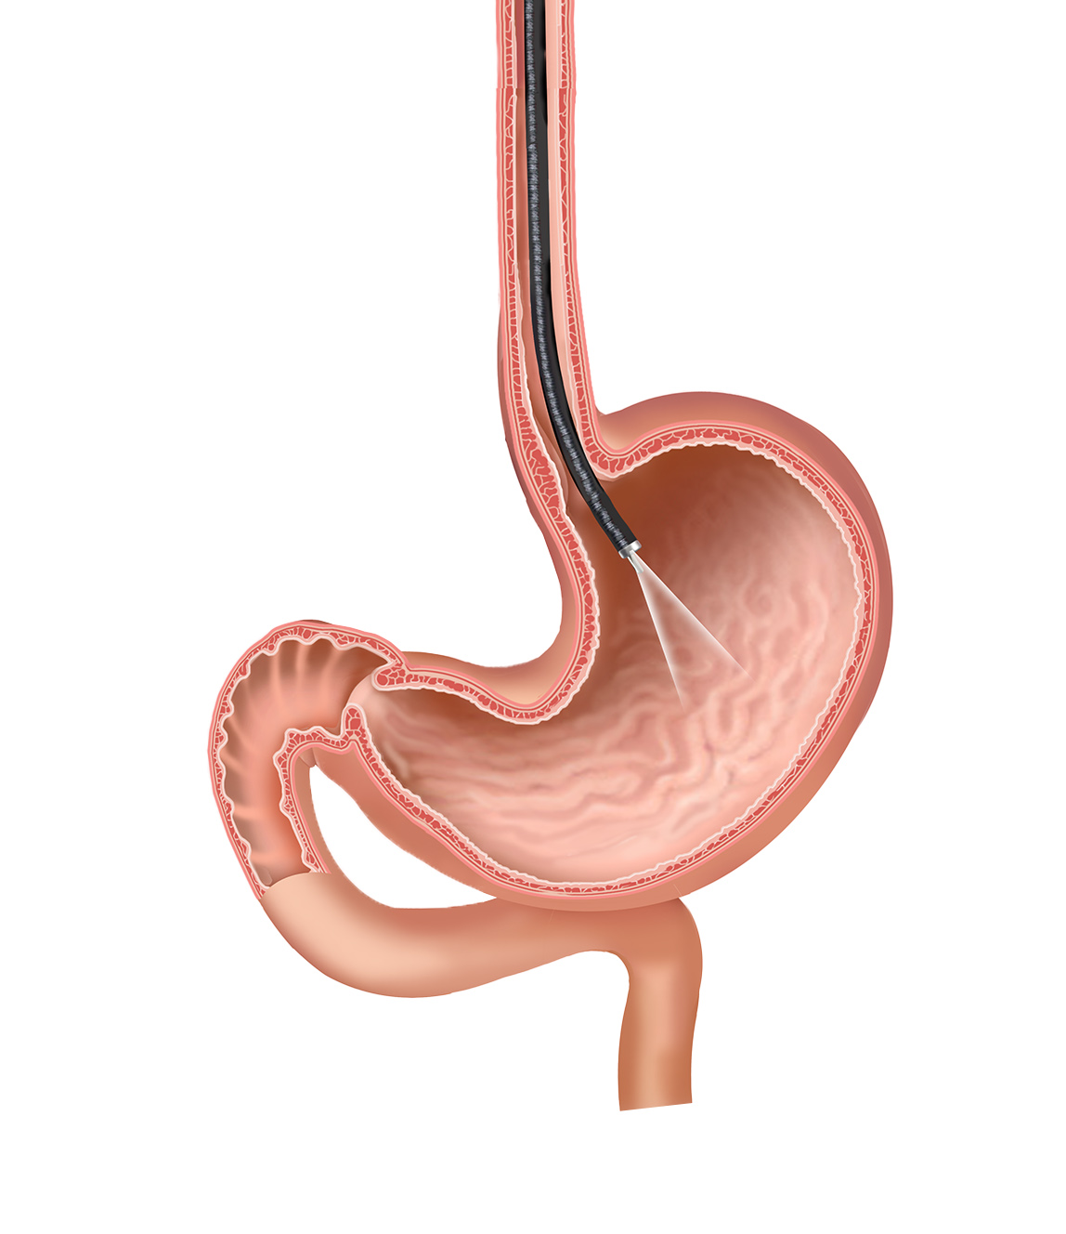

Slide 14
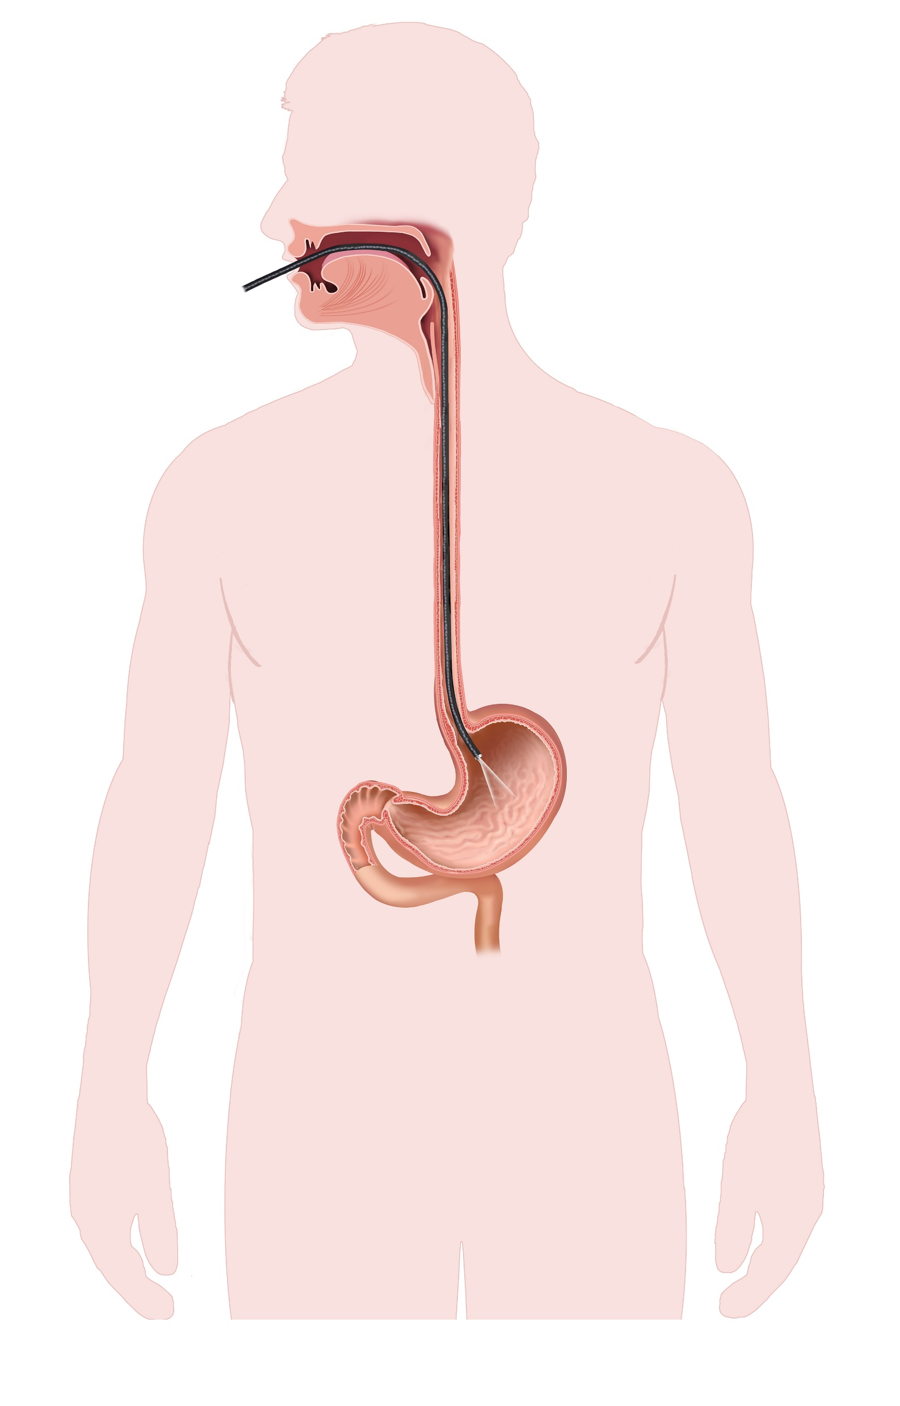
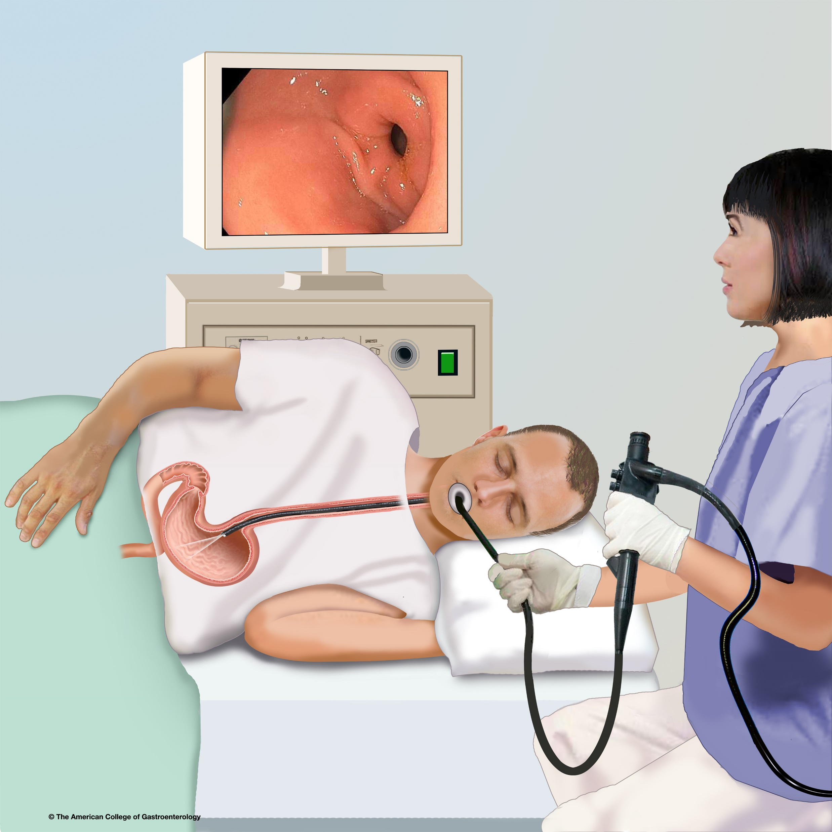
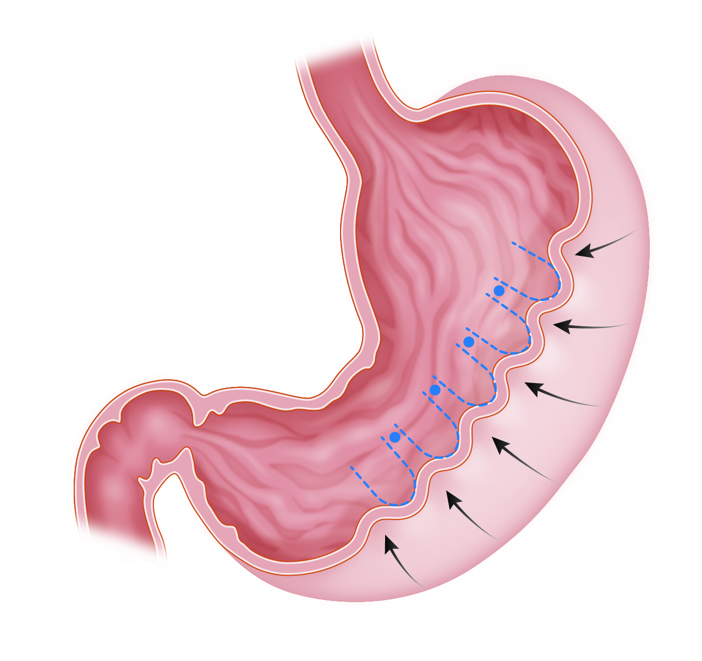

Slide 15




Slide 16




Slide 17
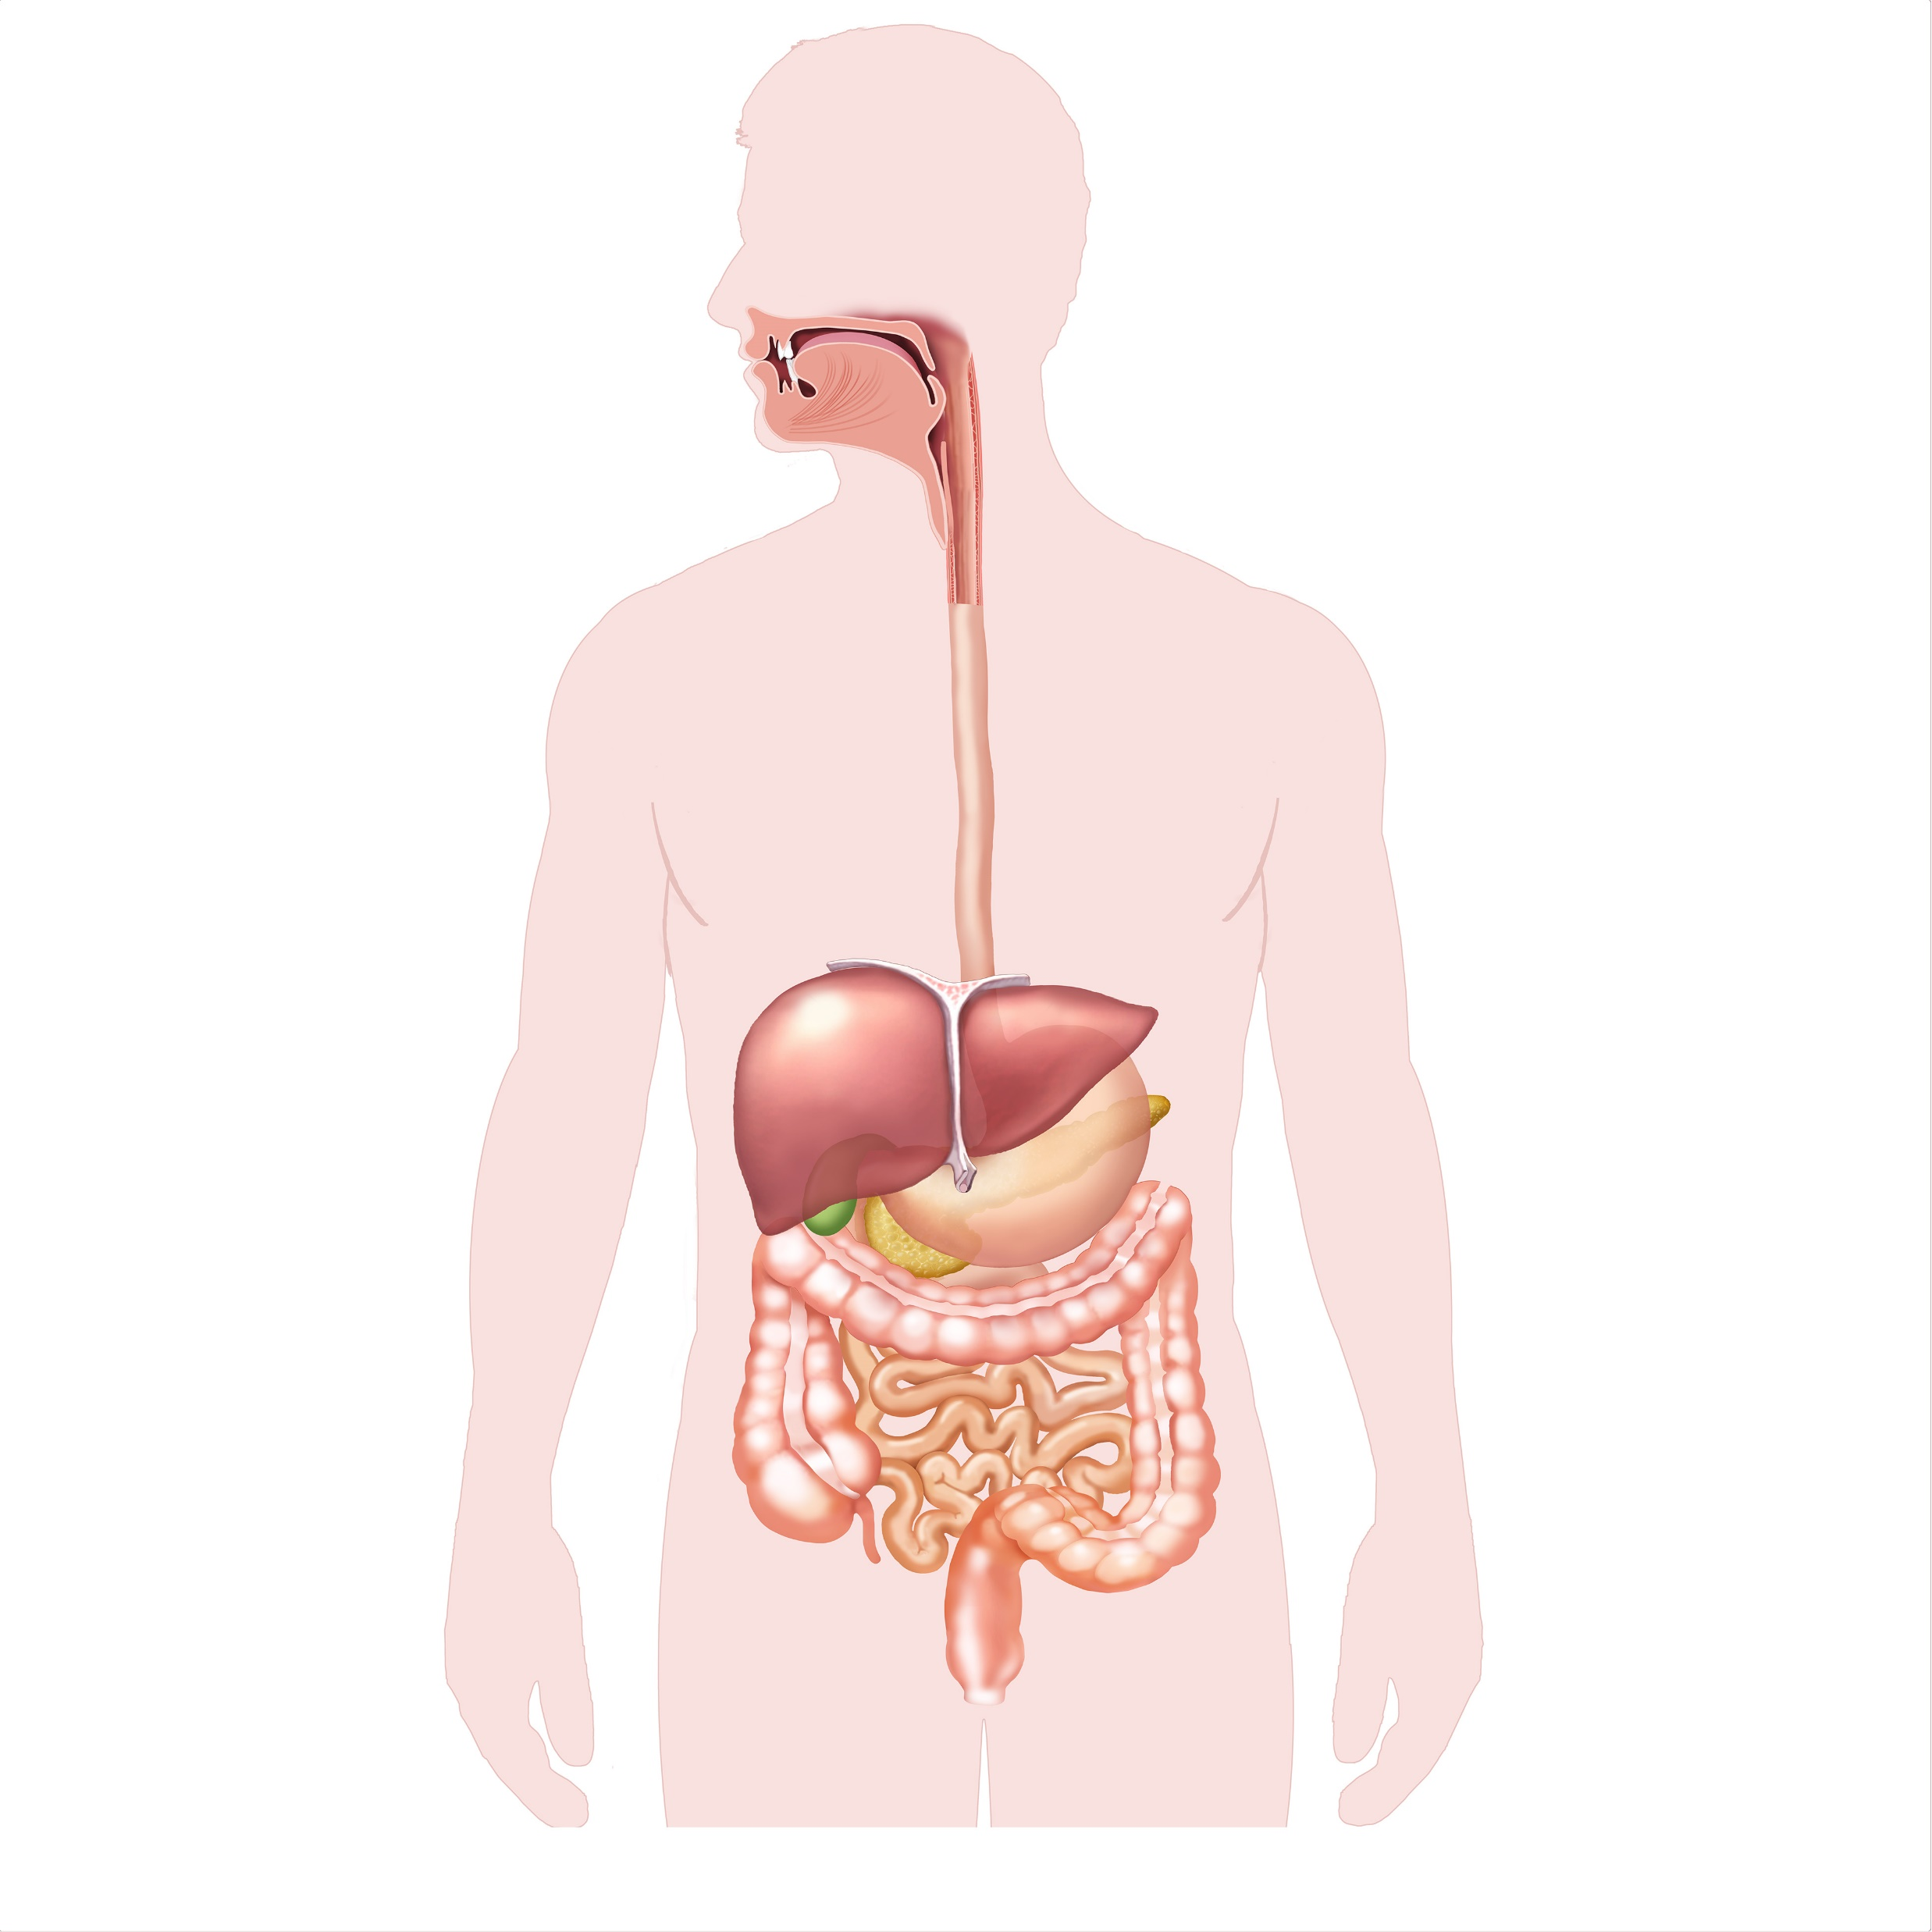



Slide 18
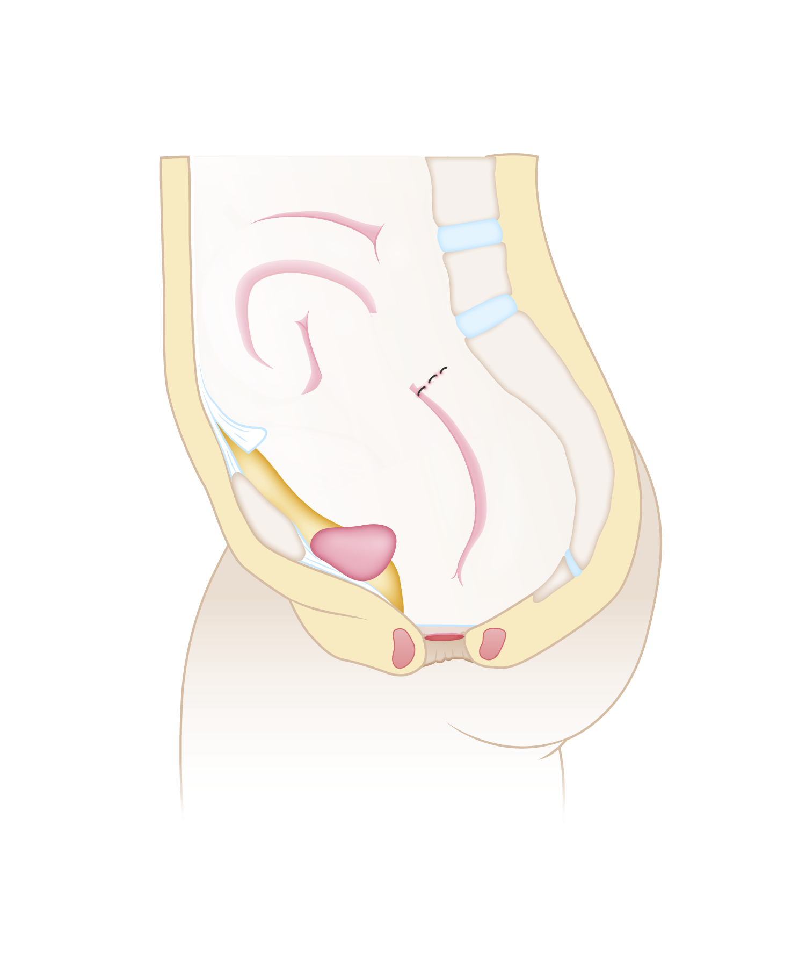



Slide 19




Slide 20




Slide 21




Slide 22




Slide 23

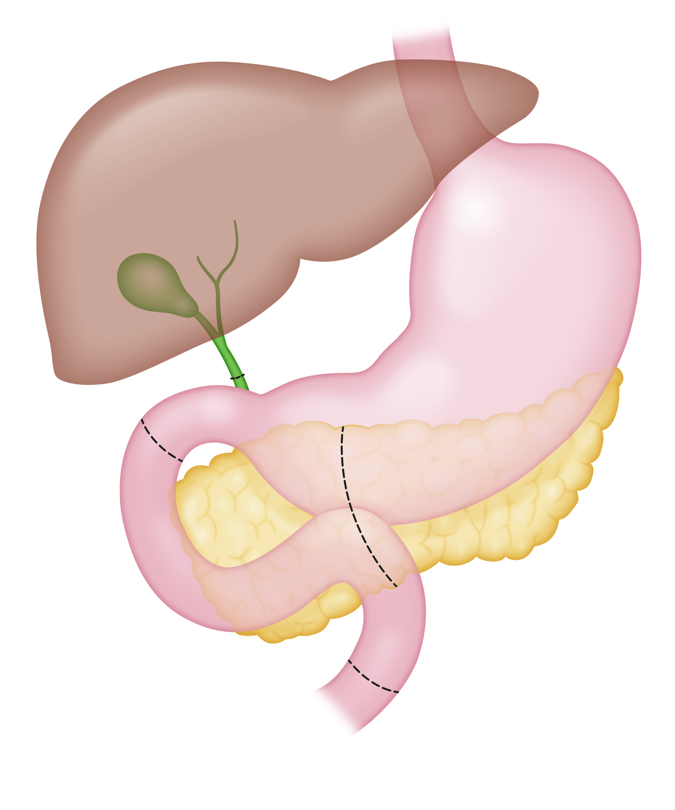
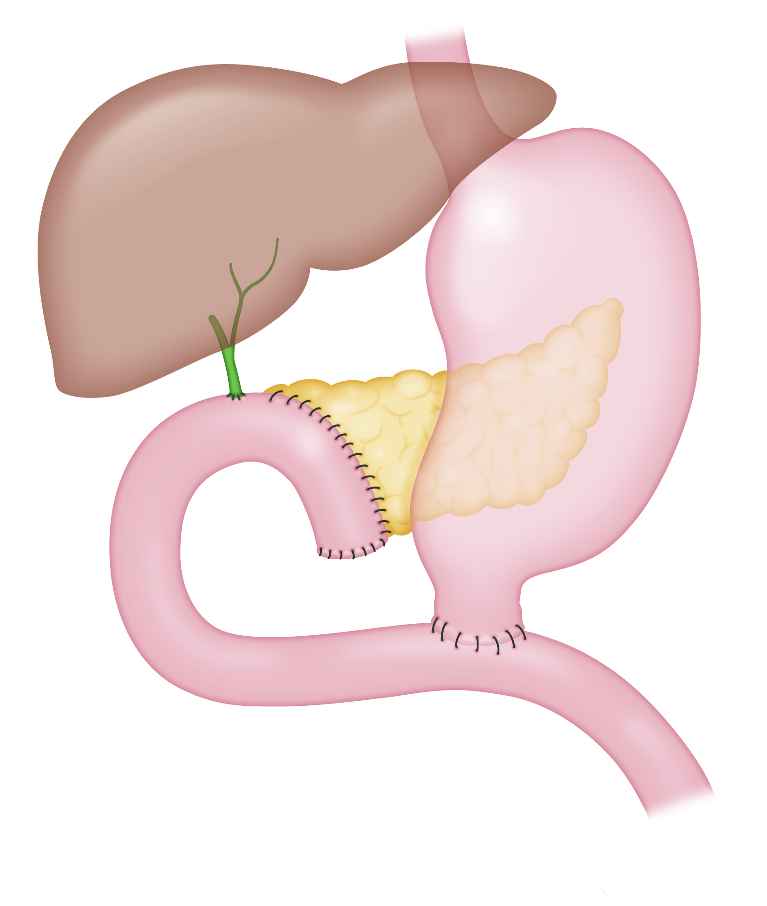

Slide 24




Slide 25

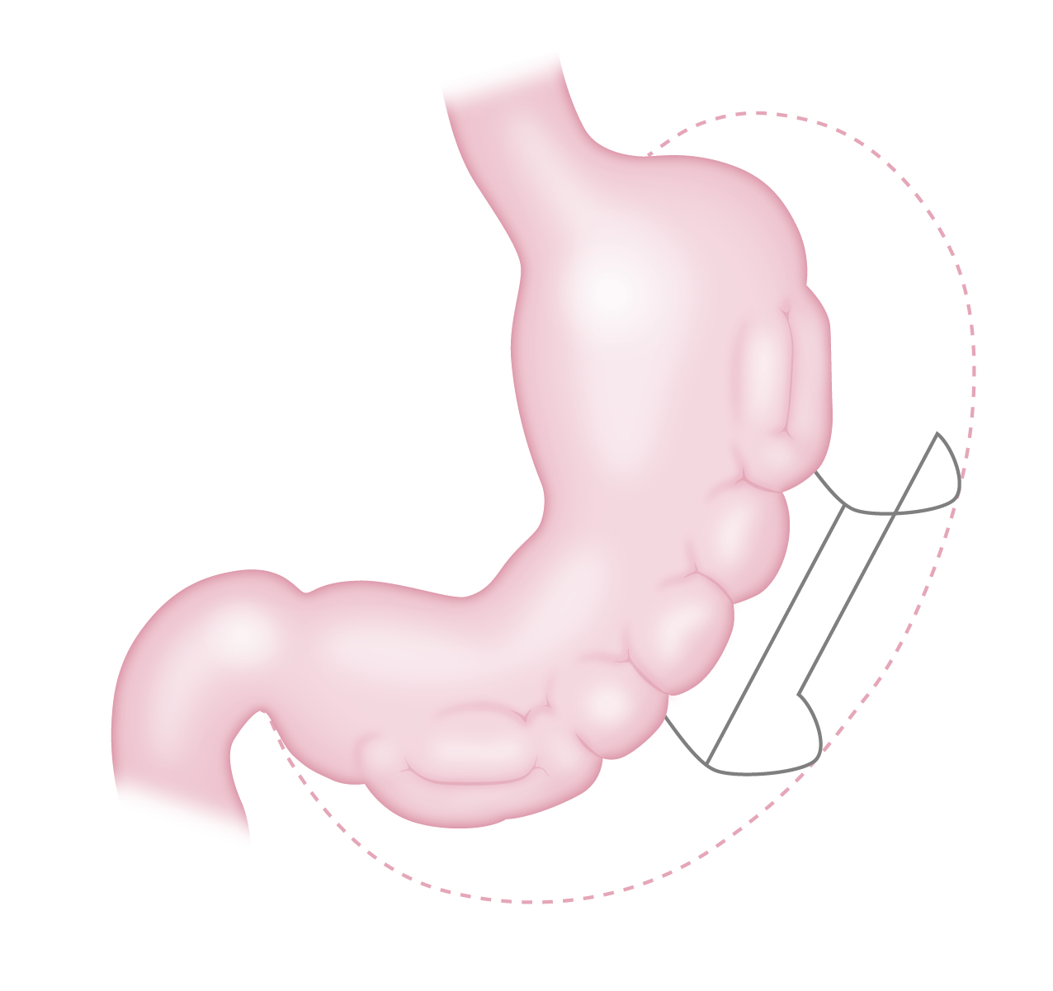


Slide 26

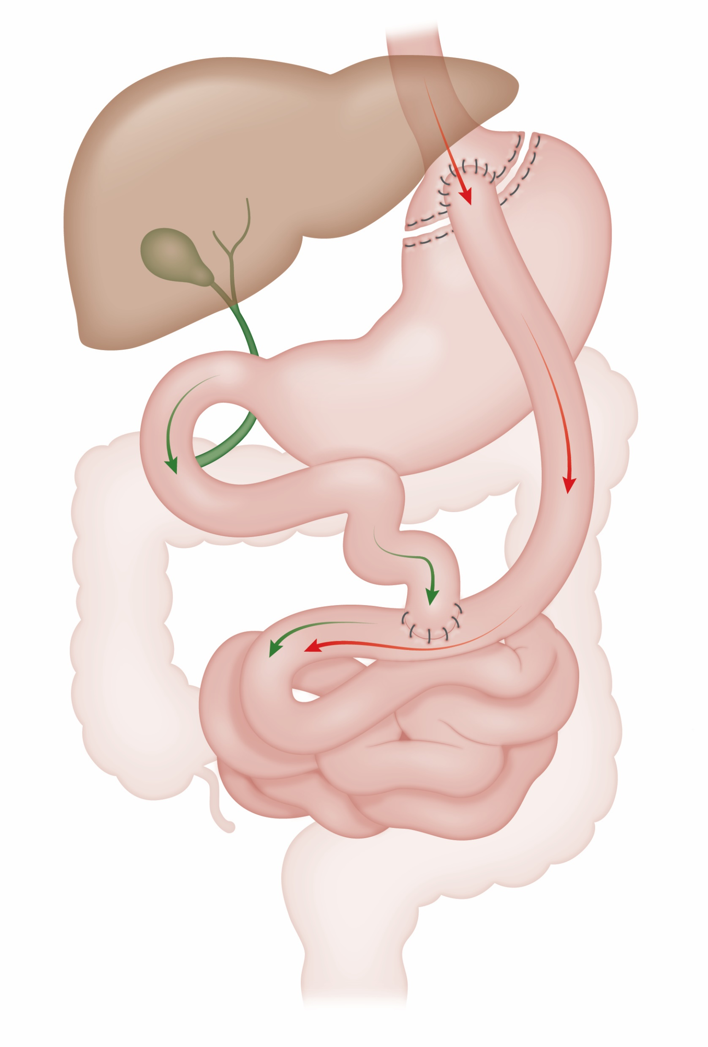


Slide 27
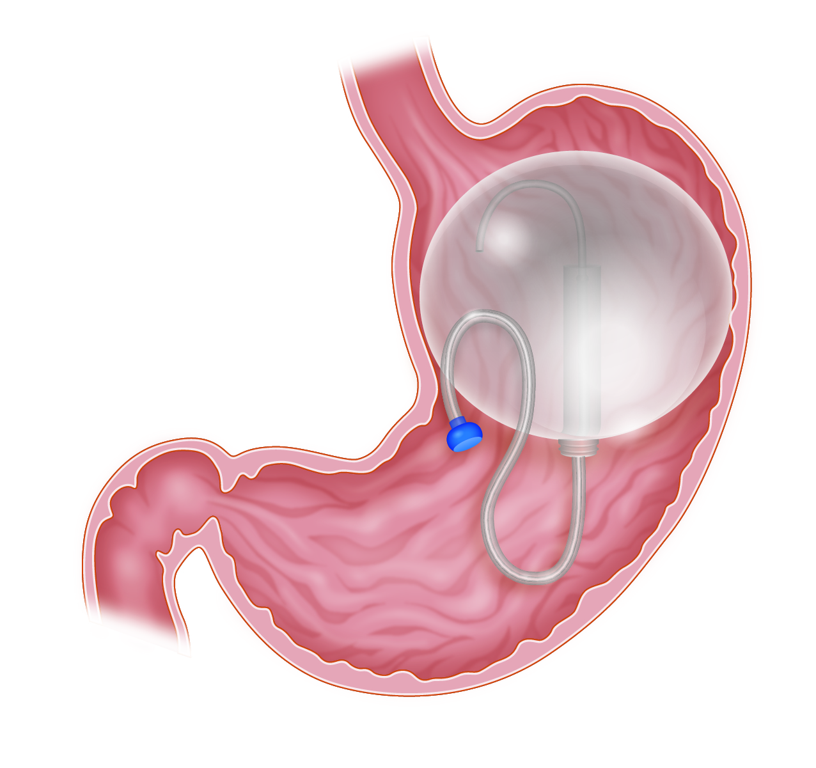


Slide 28




Slide 29
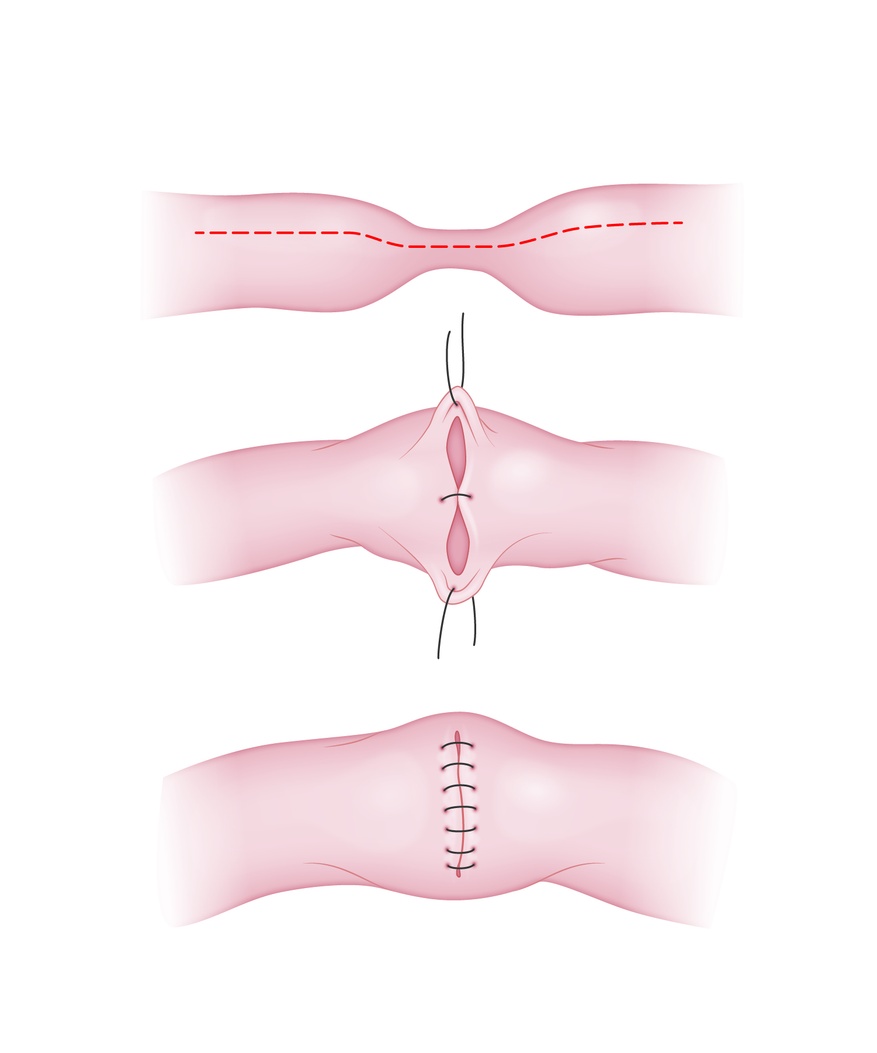



Slide 30



Slide 31


